Slide 1
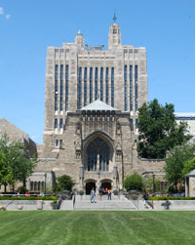
Welcome to the Graduate Writing Lab at the Yale Center for Teaching and Learning
Take a tour of the Graduate Writing Lab spaces to see where you can meet with the Graduate Writing Consultants.

Slide 2
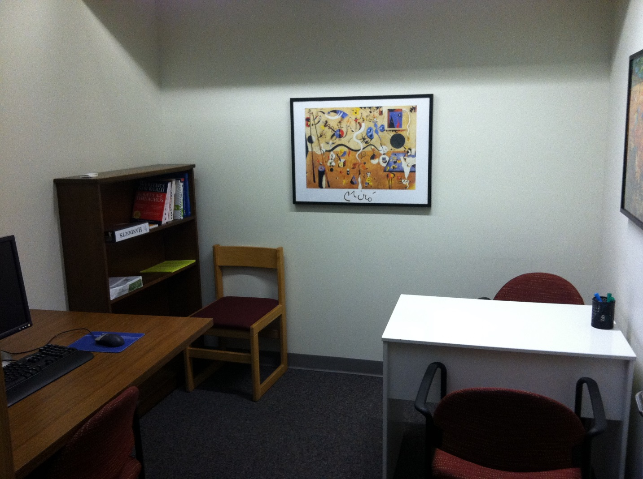
Graduate Writing Center, 35 Broadway
Most consultations with humanities and social science students take place at the Sterling Memorial Library, 301 York Street, on the mezzanine floor in rooms M104C and M104D. These well-equipped rooms are very convenient for individual discussions of written drafts and oral presentations.

Slide 3
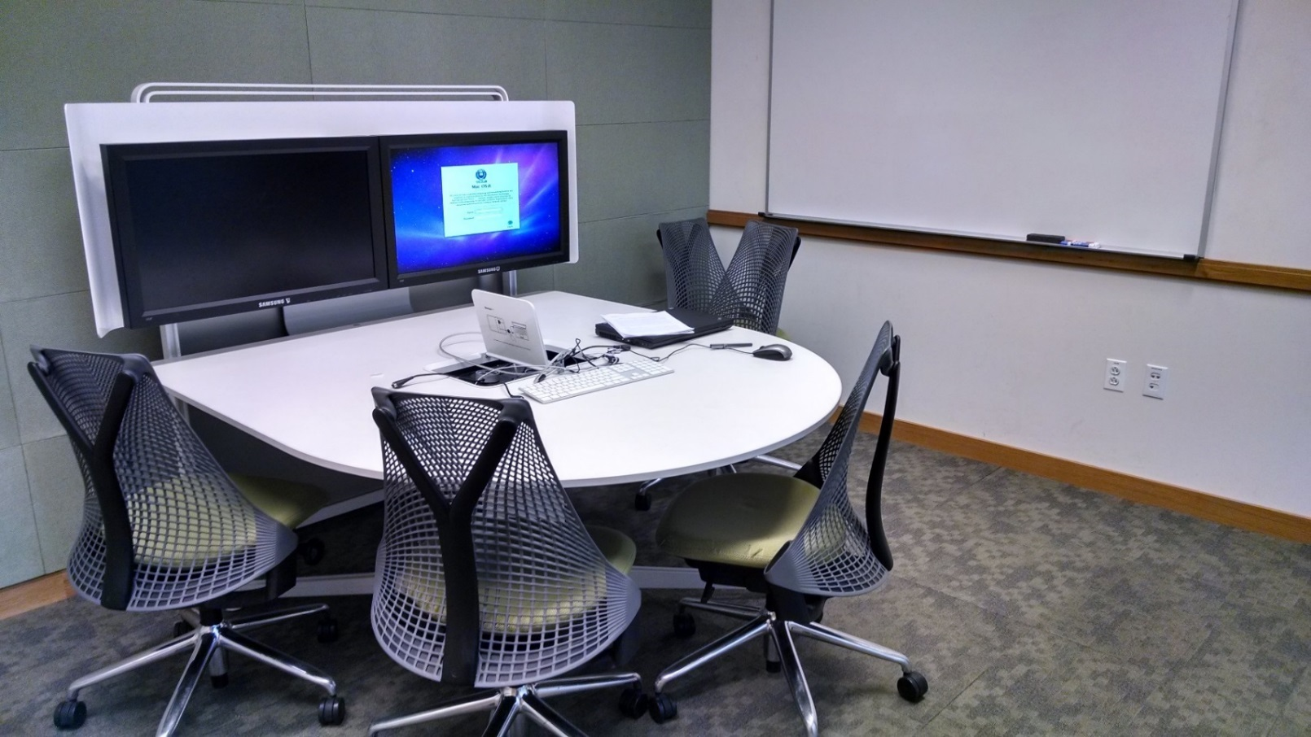
Center for Science and Social Science Information, Kline Biology Tower, 219 Prospect Street
If the Science Hill location is more convenient for you, take advantage of the GWL sessions in the CSSSi. Social Science and Science Consultants are happy to meet with you in room C20C.

Slide 4
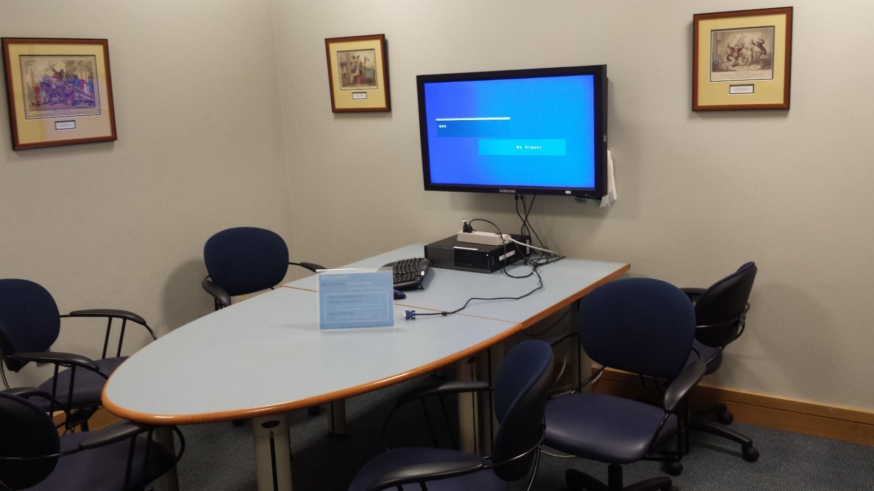
Medical Library, Sterling Hall of Medicine, 333 Cedar St.
The science and social science departments located on Medical Campus can take advantage of the cozy library locations in the Sterling Hall of Medicine (SHM). The GWL Consultants will meet with you in rooms SHM Lib101 or E24A.

Slide 5
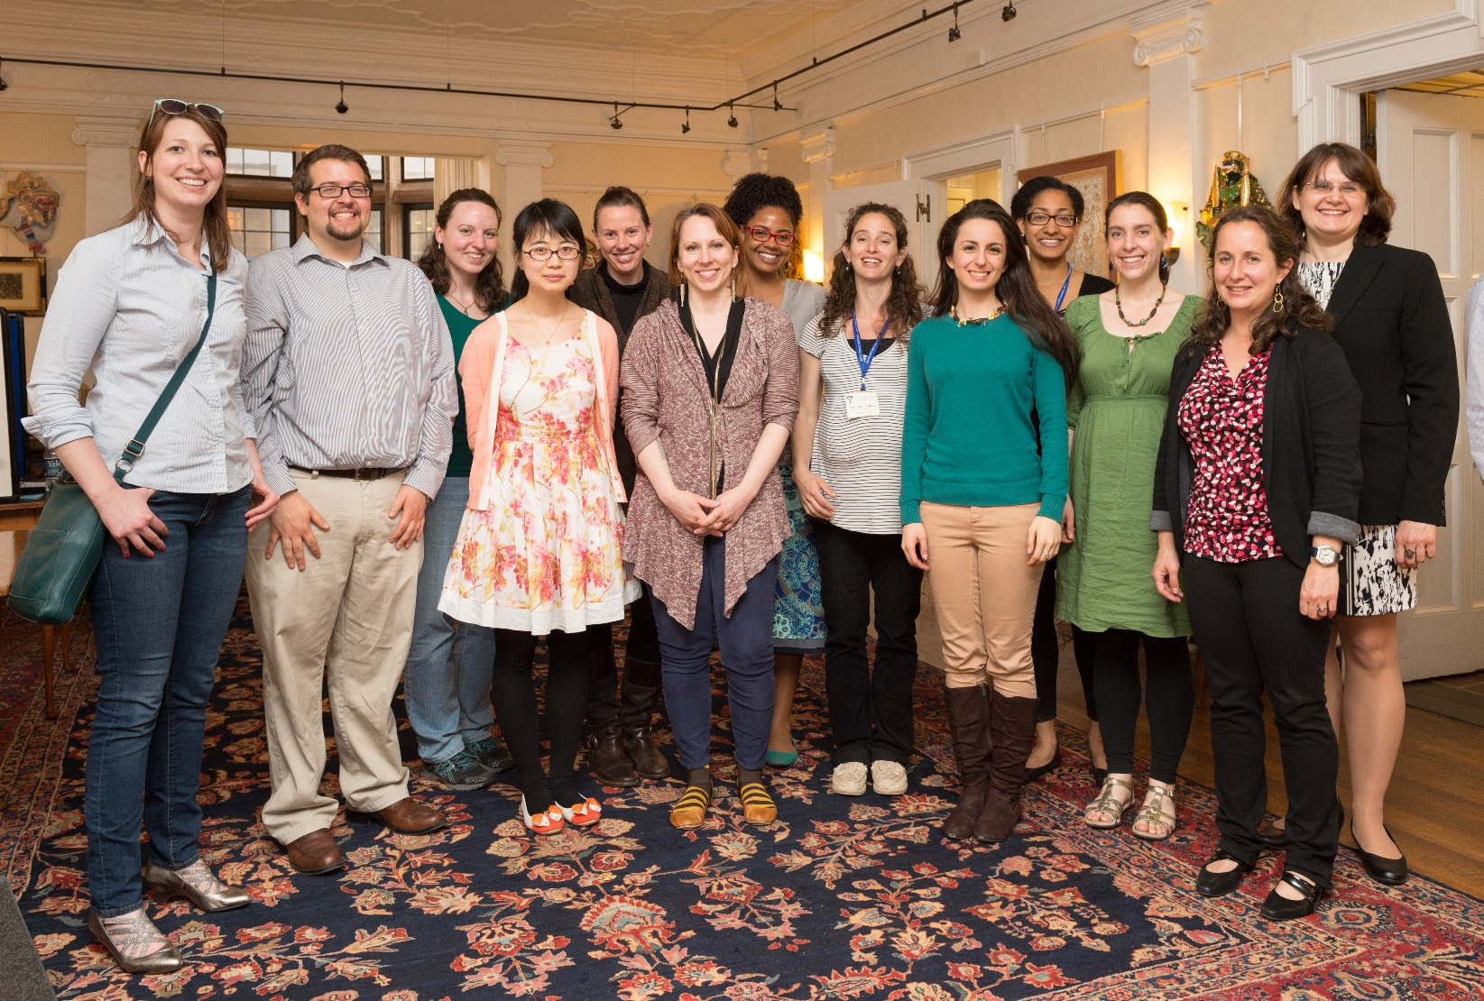
See you soon!
We look forward to meeting you at one of our locations to discuss your written work, posters, or oral presentations !
Notes:
In Slide Show mode, click the arrow to enter the PowerPoint Getting Started Center.

